Slide 1


Consulting Skills &
HODN Collaborative Consulting Program
Greg Parker, MSOD

Slide 2
Agenda
Introductions
“Let me see your watch”
Eclectic Foundations
Consulting Exercise
Resources
Collaborative Consulting (CDI & HODN)
HODN Survey

Slide 3
Introduction
Name
Experience:
  Internal Consultant
  External Consultant
  Aspiring Consultant
Current Client Status
  Searching
  Beginning
  Middle
  End
Are you:
  new to our HODN Community?
  Infrequent attendee?
  Regular attendance?
What peaked your interest to attend today?

Slide 4
“Let Me See Your Watch”
OD values and approach differentiate us from other consultants.
What we do
Where we do it
How we do it

Slide 5
Successful Strategy Implementation Requires:
Alignment of the Company’s Building Blocks
®C
Context: Business Environment, Corporate History, Competitive Landscape, Marketplace (s), Regulatory Environment
Resources
Strategic Direction
Organization Capability
Business Results
Financial Capital
Technology
Product Portfolio
Corporate Governance
Strategy
Business Model
Leadership
Organization Structure
Talent
Work Policies, Systems and Processes
Culture
Financial Return
Market Share
Share Price
Reputation
Feedback and Continuous improvement
Parlyle Consulting
®

Slide 6
Successful Strategy Implementation Requires:
Alignment of the Company’s Building Blocks
®C
Context: Business Environment, Corporate History, Competitive Landscape, Marketplace (s), Regulatory Environment
Resources
Strategic Direction
Organization Capability
Business Results
Financial Capital
Technology
Product Portfolio
Corporate Governance
Strategy
Business Model
Leadership
Organization Structure
Talent
Work Policies, Systems and Processes
Culture
Financial Return
Market Share
Share Price
Reputation
Feedback and Continuous improvement
Parlyle Consulting
®

Slide 7
ECLECTIC FOUNDATIONS
Western Philosophy
(Judeo-Christian
& Greek)
Western
Medicine
Psychiatry
Psychology
Sociology/
Anthropology
Management
Hard
Sciences
Eastern
Philosophy
(Buddhism, Hinduism, Taoism, Confucianism)
Applied Behavioral Sciences

Slide 8
ECLECTIC FOUNDATIONS
Western Philosophy
(Judeo-Christian
& Greek)
Western
Medicine
Psychiatry
Psychology
Sociology/
Anthropology
Management
Hard
Sciences
Eastern
Philosophy
(Buddhism, Hinduism, Taoism, Confucianism)
Applied Behavioral Sciences
1900
S. Freud
(Psychoanalysis)
C. Jung
(Archetypes etc.)
1910
F. Taylor
(Time & Motion)
World War One
Gestalt
1920
C. Lewin
(Field Theory)
MBTI (43)
1930
L. Von Bertalanffy
(General Systems Theory)
World War Two
W. Bion
1940
Tavistock Institute
(Socio-Analysis) (46)
NTL Institute of Applied Behavioral Sciences
(T-Group) (47)
ASTD (43)
Baton Rouge
1950
P. Drucker
Group Dynamics
D. McGregor
(Theory X-Y)
A. Maslow
Hierarch of needs)
F. Perlz, L. Perlz
I. From, P. Goodman
Socio-Technical Systems
W.E. Deming
(Statistical Process Control)
Gestalt Institute
of Cleveland (53)
C. Rogers
(Client-Center Psychology)
Emery & Trist
R. Likert (67-76)
(Participative mgt.
. Likert scale)
Tuckman (65)
Stage of Group Development)
D. Bohm
(Theoretical Physics - Dialogue)
1960
D. Beckhard
( Formula, Addison Wesley OD Series, ODN)
OD Network (67)
P. Hersey /K. Blanchard (69)
(Situational Leadership)
1970
A.K. Rice Institute (69)
(Group Relations Training)
B. Oshery (72)
(Power Labs
Tops. Middles, Bottoms))
W. Bennis,
C. Argyris
R. Schien
Nadler/Tushman
(Congruence Model)
J. Galbraith
(Organization Design)
K. Wilber (73)
(Transpersonal/
Integrative Theory)
1980
M. Porter(80)
(Strategic Planning)
Quality
(Deming, Juran, Crosby)
P. Block(87)
(Flawless Consulting)
D. Cooperrider(86)
(Appreciative Inquiry
1990
Toyota Way
Lean, Six Sigma
D. Goleman(95)
(Emotional Intelligence)
Coaching
P. Senge (90)
5th Discipline
K. Kotter (97)
(Change Mgt)
“Chaos Theory”
Meg Wheatley (92)
(Leadership & New Science)
2000
Neuroscience
Quality Institute
Houston, TX (94)
D. Rock
(Neuroleadership)
2010
Parlyle Consulting ©

Slide 9
Consulting Exercise
In Pairs explore, discuss and “record” your responses to the follow questions:
  “ When I am having difficulty making progress with my client(s) I feel _________”
  When this happens I typically (do)_____________
  As a result, My client typically (does, feels, thinks) __________
  I know this because I ______________
Take notes on a post-it
Place the post-it notes on the appropriate flip chart sheet

Slide 10
Books That Have Influenced Me
Flawless Consulting | Peter Block
Process Consulting | Ed. Schein
Humble Inquiry | Schein
Helping | Schein
Humble Consulting | Schein
The Consulting Process In Action | Lippitt & Lippitt
Organizational Consulting a Gestalt Approach | Ed. Nevis
The Fifth Discipline Fieldbook | Peter Senge, et. al.
The Trusted Advisor (and Fieldbook) | Charlie Green, et. al.
Intervention Skills | Brendan Reddy
The Consultants Calling | Bellman

Slide 11
Books That Have Influenced Me
Flawless Consulting | Peter Block | A +
Process Consulting | Ed. Schein | A
Humble Inquiry | Schein | B
Helping | Schein | A
Humble Consulting | Schein | B
The Consulting Process In Action | Lippitt & Lippitt | D
Organizational Consulting a Gestalt Approach | Ed. Nevis | A+
The Fifth Discipline Fieldbook | Peter Senge, et. al. | B
The Trusted Advisor (and Fieldbook) | Charlie Green, et. al. | A
Intervention Skills | Brendan Reddy | A+
The Consultants Calling | Bellman | C

Slide 12

Collaborative Consulting
Participants invest a Total of 17 hours in their professional development over eight weeks.
Blended Learning: Consulting Experience, On-line Video and Exam, Journaling, Weekly Teleconference, Facilitator and Peer Coaching
Cohort groups meet weekly with their facilitator to debrief and share their learning. As the group chooses, this can be in-person of via teleconference. Experienced consultants from our own HODN community will facilitate each cohort group.
All cohort groups will jointly meet in-person for a 90-minute kickoff event.( Before April HODN Meeting). Each week there after each individual cohort group will meet separately.
Weekly Topics and Skills:
  Kick-off: Form Cohort Groups and OD – an eclectic mix of knowledge and skill
  Collaborative Consulting for Performance, Change and Learning
  Contracting
  Discovery
  Action Planning
  Implementation
  Evaluation
  Termination
Members Only
HODN charges $195 per participant
Facilitator time is bro-bono

Slide 13
Mission of Consultants Development Institute
Provide highly affordable and accessible consultant training and development
Provide the nuts-and-bolts, comprehensive knowledge and resources needed for a firm foundation in any approach to consulting
Provide guidelines for consultants to work in an authentic and highly collaborative manner with their clients
Provide a vast range of practical resources that can be applied right away
Provide ongoing guidance and support to apply new learning from CDI’s courses and Certificate-Series
Houston, Minn, NJ, Md OD Chapters are using CDI Courses and Certification.

Slide 14
Collaborative Consulting for Performance,
Change and Learning
The collaborative consulting cycle provides a flexible framework in which you and your clients continually coordinate, dialogue and learn about the best actions to take to improve the performance of their organizations.
Ultimately, collaborative consulting is really a philosophy.
It is based on the belief that true change and learning will not take place with your client unless your client shows strong ownership, participation and commitment in that overall process of change and learning.

Slide 15
Blended Learning
Training Video (30 minutes)
Pre and Post Assessments
Learning Journal
Seven 90-minute virtual meetings (cohort)
Session Quiz – 80 required score
Practical downloadable tools.
Sources for Additional Learning (recommended interactive exercise(s), book(s), discussion group and questions for reflection about the topic)

Slide 16
Learning and Development Journal
Research shows that adults learn best when they carefully reflect on their own experiences.
Therefore, skills in reflection are critical for professional learning and development.
Your "Learning and Development Journal for CDI Courses" is where you document all of your important reflections and learning during the activities in a CDI course.
You then discuss your learnings during the virtual meetings in your cohort.

Slide 17
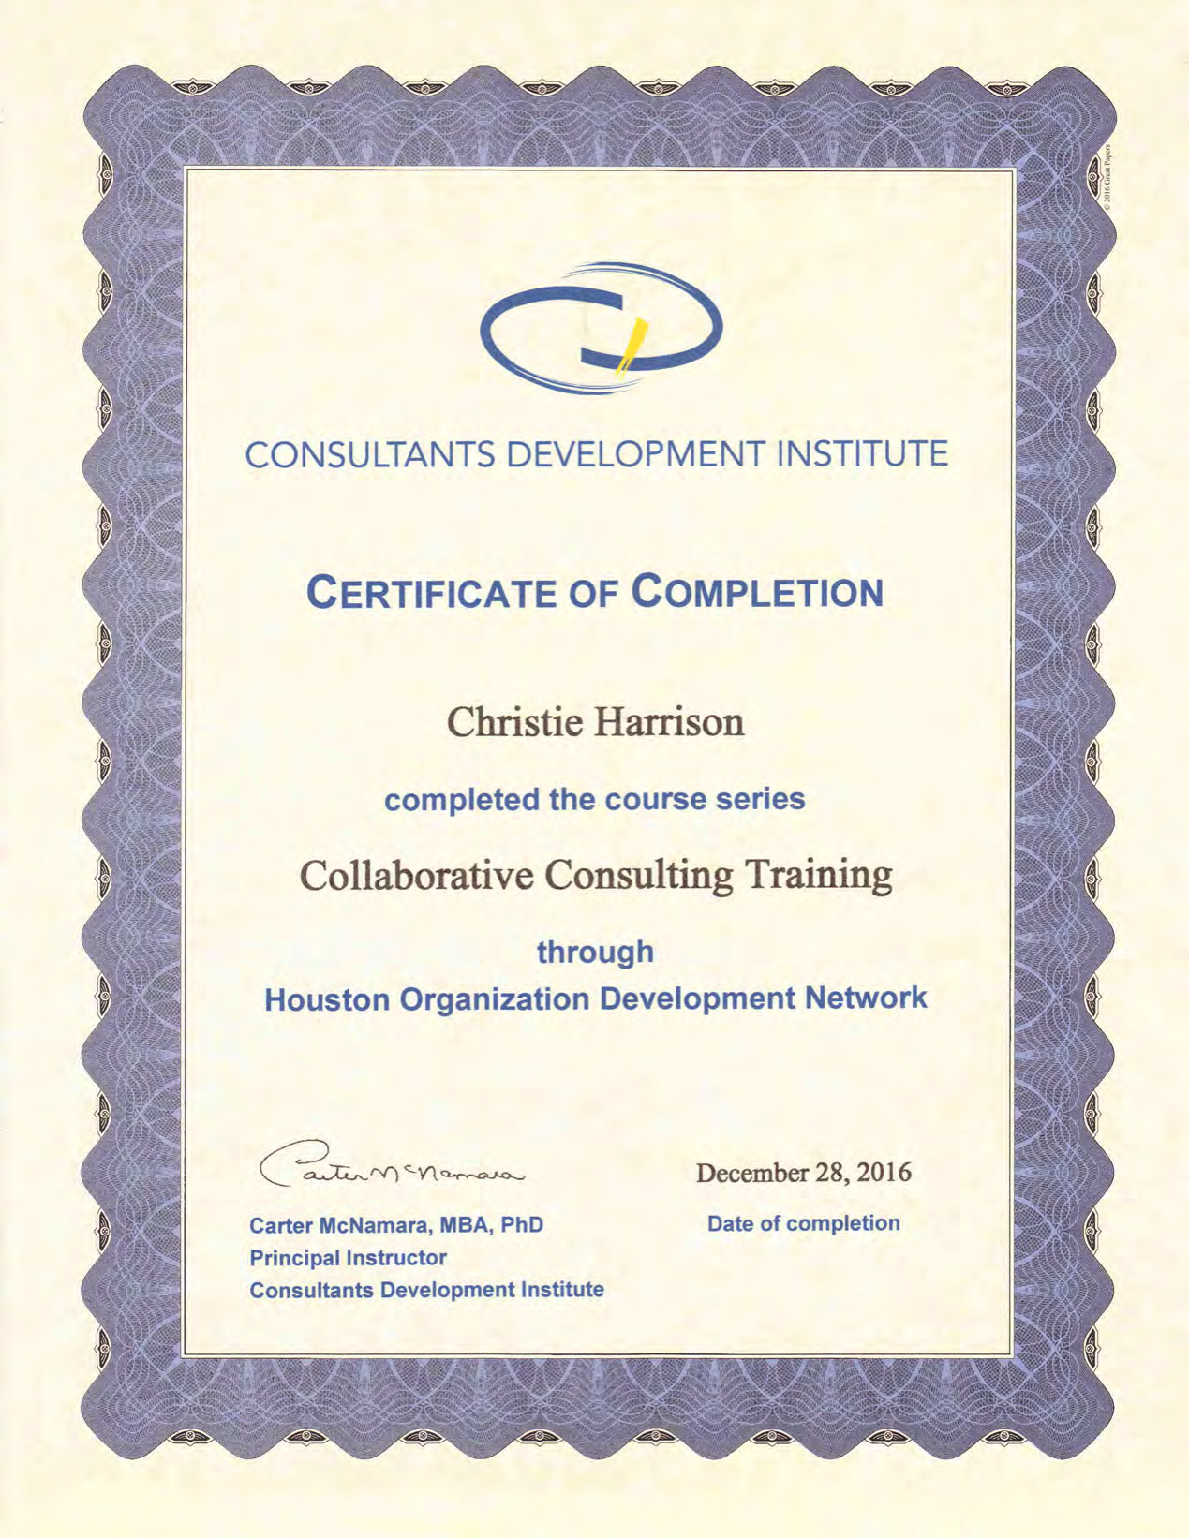

Slide 18
Back –Up Slides

Slide 19

Carter McNamara
CDI was founded in 2013 by Carter McNamara, MBA, PhD, a principal consultant in CDI, and founding partner of Authenticity Consulting, LLC. He has been training consultants since the 1990s.
Carter is the Lecturer for the 7 Video Sessions.

Slide 20
Gestalt Cycle of Experience
Sensation
Awareness
Energy Mobilization
Action
Contact
Resolution Closure
Withdrawal of Attention

