Slide 1
Learning Development . . . My Journey
By
Roger Gordon

Slide 2
Background
Retail Management with Sears 1972
Manager Business Systems Center 1984
Started ConX Solutions to train on consultative selling skills 1988
Joined GN Resources1995 and launched HRNEWCORP in 2000
Returned to Corporate L&D 2009
Helped two global Organizations create Learning cultures based on Core Values

Slide 3

What I Will Cover . . .
How to get Management buy-in;
The changing demands of a V.U.C.A. workplace;
New skills Leaders will need to develop, and
What Newpark Resources is doing different today.

Slide 4


Slide 5

How to Get Management
Buy-in?
Know what is important
  What needs to be sustained
  What needs to be developed
  What needs to be prevented
Focus on value-creation
  Engagement Levels
  Developing Managers
  Attracting and Retaining Talent
  Increasing Productivity

Slide 6
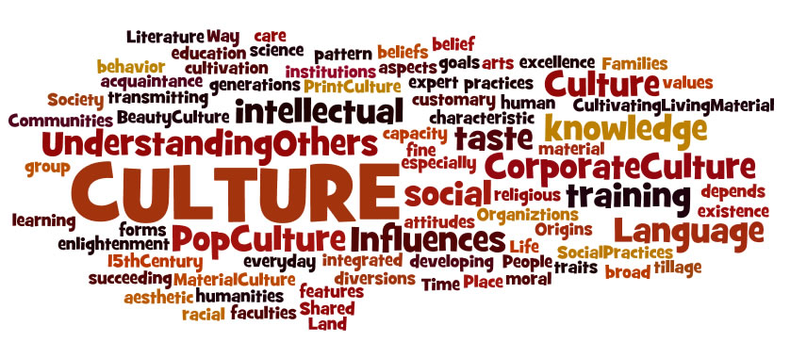
Focus on Culture
Cultures with strong Leadership development have 2-X’s Revenue and Profit growth (CEB/Gartner)
“Don’t let what you can’t do get in the way of what you can do”
Start at the Top and then work your way down
  “The shadow of the Leader is the culture of the Organization”
Culture first. . .

Slide 7

Why Culture is Important
Culture eats innovation for breakfast
Observable behaviors are the real culture of a company
Core Values describe Desired Behaviors
How can you change behaviors?
  You can’t change who people are but you can help them modify their behaviors

Slide 8
Engagement

Slide 9
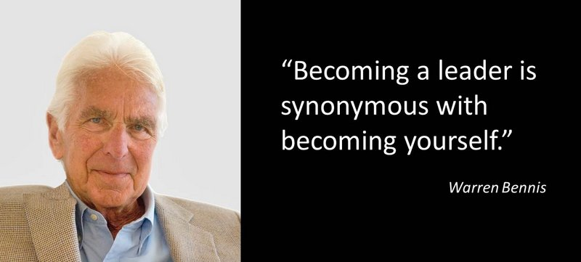
Manager Awareness
Identity versus Reputation
“The you that you know is not worth knowing” – Dr. Robert Hogan
“Knowing yourself is the beginning of all Wisdom” - Aristotle

Slide 10
Observed Behaviors
WORST
BEST
Withholds Knowledge
Apathetic
Poor communication
Gets angry
Lack of Trust
Bad work ethics
Lack of direction or goals
Not cooperative
Lack of energy
Complains and blames others
Dominant Management style
Doesn’t care
Not open to others opinions
Perceived to be focused on Self
Shares Knowledge, helps me develop
Empathetic
Good communicator
Manages emotions
Trusting and Respectful
Good role model
Clear objectives and goals
Cooperative
Focuses on Solving Problems
Positive energy
Coaching Management style
Shows care
Encourages Participation
Perceived to be focused on others

Slide 11

2) The Demands of a V.U.C.A. Workplace

Slide 12
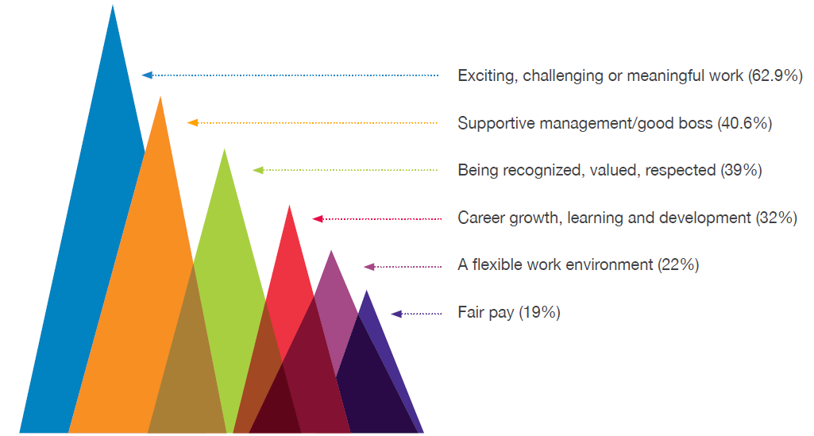
What Employees want
© Beverly Kaye, Sharon Jordan-Evans and Career Systems International.

Slide 13
Changing Trends
Technology continues to grow exponentially every
18-months. . . (Moore’s Law)
People skills and building relationships are becoming more valued . . . however,
Relationship skills are atrophying . . .
Only 1/3rd of teens say they have meaningful face-to-face interactions after school
(Geoff Colvin/ “Humans are Underrated” 2015)

Slide 14
Workforce
Millennials will be 50% of the workforce by 2020
Average Millennial will change jobs every 3-years
For every employee you hire, two will be exiting, creating a 3:1 ratio (DOL 2015)
Time-to-hire has increased +30-days since 2010
(Gartner 2017/Q-III)
Today, 20% of the workforce are gig workers . . . this will grow to 40% by 2025 (Intuit)

Slide 15
Technology
Big Data
Internet of Things
IoT
Graphene
Augmented Reality

Slide 16

Graphene:
Material of Tomorrow

Slide 17
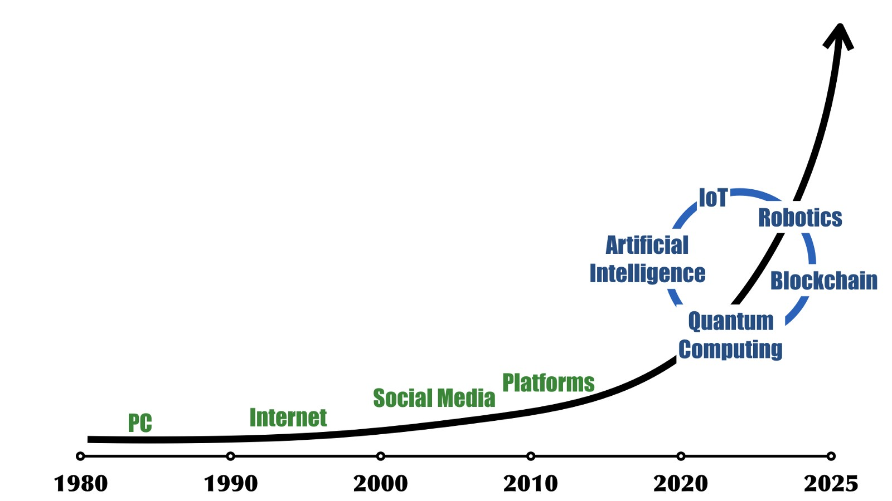
The Big Shift
How does this affect managing people?

Slide 18
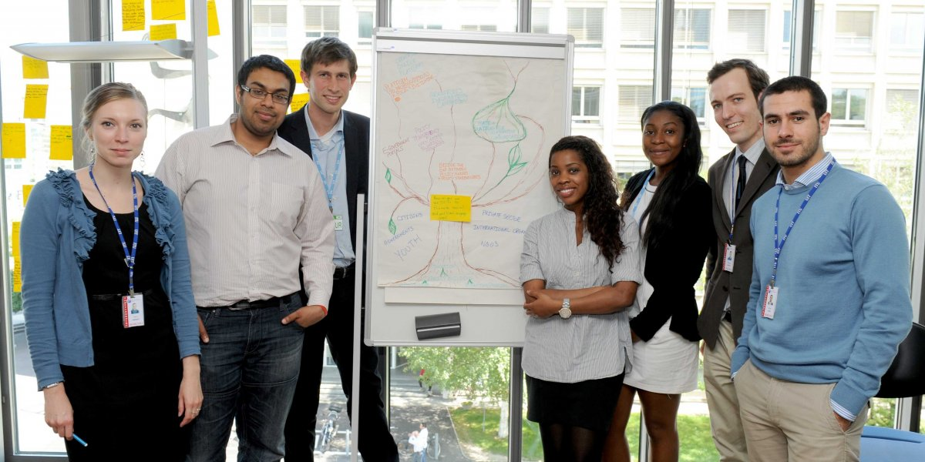
3) What Skills Will Be Needed?

Slide 19

The Leadership Challenge
Leaders today are not prepared for Leadership of tomorrow
Future leadership requires Resiliency, Agility and Continuous Learning
Companies must differentiate the skills
of “Leadership” from those of “Job
Enlargement”

Slide 20

What Does This Say About Coaching Employees?
  95% of HR executives say annual performance reviews aren’t useful (Gartner – CEB)
80% of workers are dissatisfied with their performance reviews (Deloitte)
70% of companies are already considering alternatives (Gartner – CEB)
Performance Reviews will
need to change

Slide 21

Discussions with Employees
Millennials want to be recognized, valued and respected
Leaders need to have more frequent
and informal chats with employees
Career discussions should be focused
on retention, recognition, engagement,
work-life balance and future aspirations
Smart companies will use engagement
as a loyalty differentiator

Slide 22
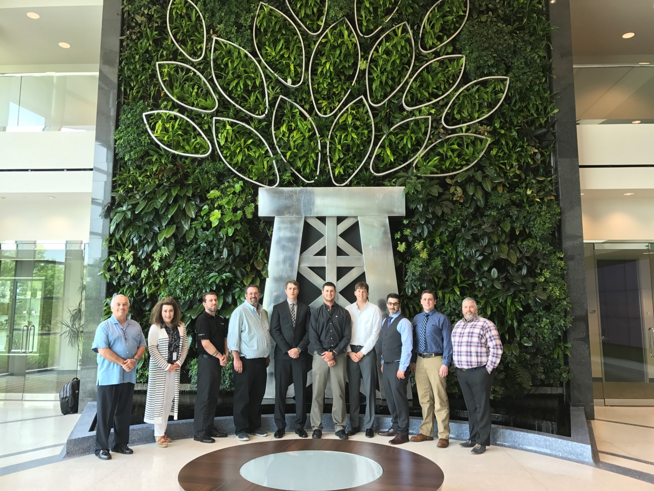
4) What is Newpark Doing . . .
C.H.A.T.
Talk-Talent
C.A.R.E.E.R.

Slide 23
C.H.A.T. sessions
Frequent informal discussions between employee and Managers
Owned by the employee with no HR involvement
Talk about short-term or longer-term needs

Slide 24
Talk-Talent Workshops
Starts with Executive Team
Discuss direct-report managers
Rate on Performance criteria and Leadership Potential
Distinguish between “Job Enlargement” and “Leadership Potential”
Repeat annually

Slide 25

C.A.R.E.E.R.
In development . . .
For High Potential individuals
In-depth discussions hosted by their manager and HR partner
Focusing on:
  Core Values, Aspirations, Responsibilities, Engagement, and Range of skills

Slide 26
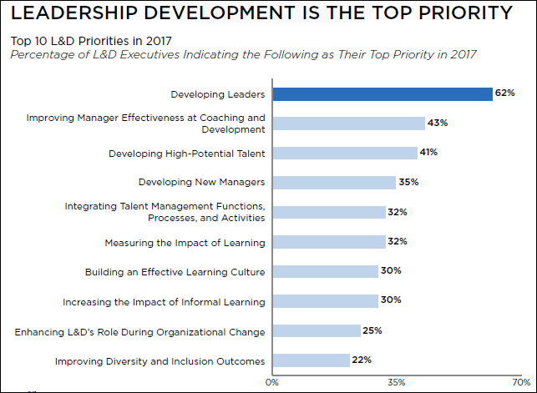

Slide 27

Future Leaders
Will need:
To be Learning Agile
To Show Empathy
To Actively Listen
To be an effective coach
To use Collaborative
problem solving
To analyze big-data
To be resilient and self-aware

Slide 28

Summary
What got us here won’t get us there
Artificial intelligence, virtual reality, nano-technology, and the digital explosion will drive the Big Shift
Agility is required in a V.U.C.A. world
Leaders of tomorrow
will need to learn many
new skills
Self-awareness is
foundational to Leadership
success

Slide 29

Workplace of the Future
Are You Ready?
Notes:
40:00 minutes

